Slide 1
R/qtl-PartI
Does [0] compute?
Li Lei
March 7th, 2017

Slide 2
R/qtl
An extensible, interactive environment for mapping quantitative trait loci (QTL) in experimental crosses.
An add-on package for R
Developed by Karl W Broman, U. Wisconsin–Madison
Unix or Windows or Mac

Slide 4
What is genetic map?
Describe the linear order of markers (e.g. SSRs & SNPs) within a linkage group
Recombination fraction:
- A measure of the distance between two markers
- The percentage of recombinant progeny produced in a cross
Recombination frequency = (#recombinant gametes/total gametes) x
100%
Two markers that show 1% recombination are defined as being 1 centimorgan (cM) apart on a genetic map.
1 map unit = 1 cM (centimorgan)
0.1cM
M1
Linkage Group
M2
0.2cM
M3
0.25cM
0.1cM
M4
M6

Slide 5
The general process of making genetic map
Load marker status for all individuals
Check similarity of markers
Check similarity of individuals
Check segregation distortion
Exclude markers or individuals
Construct genetic map

Slide 7
Genetic linkage map construction
Home work
R/qtl:
http://www.rqtl.org/tutorials/geneticmaps.pdf
Practice data
http://www.rqtl.org/tutorials/mapthis.csv

Slide 8
Flow Chart for QTL mapping
Parent A
Parent B
Segregation population construction (RIL/DH/F2/F3 )
Genotyping with molecular markers
Phenotyping for each line
Construct genetic linkage map
Linking phenotype data with genotype data -- Mapping Tools
Trait QTL mapped to a particular chromosome

Slide 9
LOD SCORE
The LOD score: Logarithm of Odds (LOD) score
LOD = Z = _{Log10} probability of birth sequence with a given linkage
probability of birth sequence with no linkage
By convention, a LOD score greater than 3.0 is considered evidence for linkage.
On the other hand, a LOD score less than -2.0 is considered evidence to exclude linkage.

Slide 10
QTL detection
Get the mark location from genetic linkage map
Combine the phenotype, marker location and marker status
Choose right mapping functions: Haldane’s, Kosambi’s…
Choose right model based on the phenotype data, e.g. normal, binary, nonparamatric model, etc.
Choose right methods to evaluate the statistical significance : em, imp…
Evaluate the statistical significance
Significant threshold
Interval estimate of QTL location
QTL effects

Slide 11
Mapping function
The genetic distance between locus A and locus B is defined as the average number of crossovers occurring in the interval AB
Mapping function is use to translate recombination fractions into genetic distances
In 1919 the British geneticist J, B. S. Haldane proposed
Haldane defined the genetic distance, x, between two loci as the average number of crossovers per meiosis in the interval between the two loci.

Slide 12
What is Haldane ’s mapping function ?
Assumptions: crossovers occurred at random along the chromosome and that the probability of a crossover at one position along the chromosome was independent of the probability of a crossover at another position.
Using these assumptions, he derived the following relationship between
Ø, the recombination fraction and
x ,the genetic distance (in morgans):
Ø=1/2(1-e^{-2x}) or equivalently,
X=-1/2ln(1-2Ø)

Slide 13
Models based on the phenotype data
Normal model: a standard model for QTL mapping (see Lander and Botstein 1989). The residual phenotypic variation is assumed to follow a normal distribution, and analysis is analogous to analysis of variance.
Binary model: for the case of a binary phenotype, which must have values 0 and 1. The proportions of 1’s in the different genotype groups are compared. Currently only methods em, hk, and mr are available for this model. See Xu and Atchley (1996) and Broman (2003).
Non-parametric "model”: with this model, an extension of the Kruskal-Wallis test is used; this is similar to the method described by Kruglyak and Lander (1995). In the case of incomplete genotype information (such as at locations between genetic markers), the Kruskal-Wallis statistic is modified so that the rank for each individual is weighted by the genotype probabilities, analogous to Haley- Knott regression. For this method, if the argument ties.random is TRUE, ties in the phenotypes are assigned random ranks; if it is FALSE, average ranks are used and a corrected LOD score is calculate. Currently the method argument is ignored for this model.

Slide 14
Methods to evaluate the statistical significance
em: maximum likelihood is performed via the EM algorithm (Dempster et al. 1977), first used in this context by Lander and Botstein (1989).
imp: multiple imputation is used, as described by Sen and Churchill (2001).
hk: Haley-Knott regression is used (regression of the phenotypes on the multipoint QTL genotype probabilities), as described by Haley and Knott (1992).
ehk: the extended Haley-Knott method is used (like H-K, but taking account of the variances), as described in Feenstra et al. (2006).

Slide 15
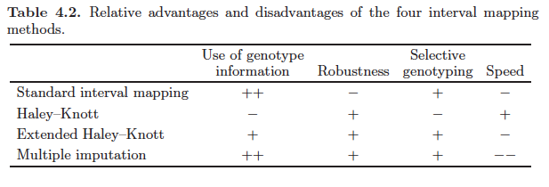
(HK)
(EHK)
(IMP)

Slide 16
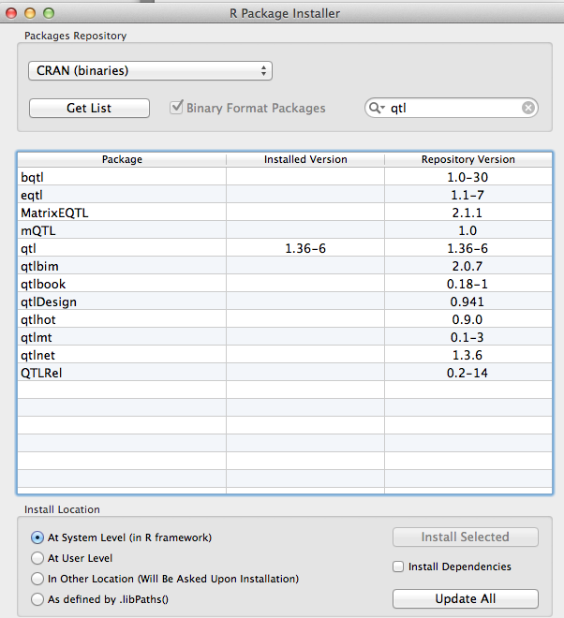
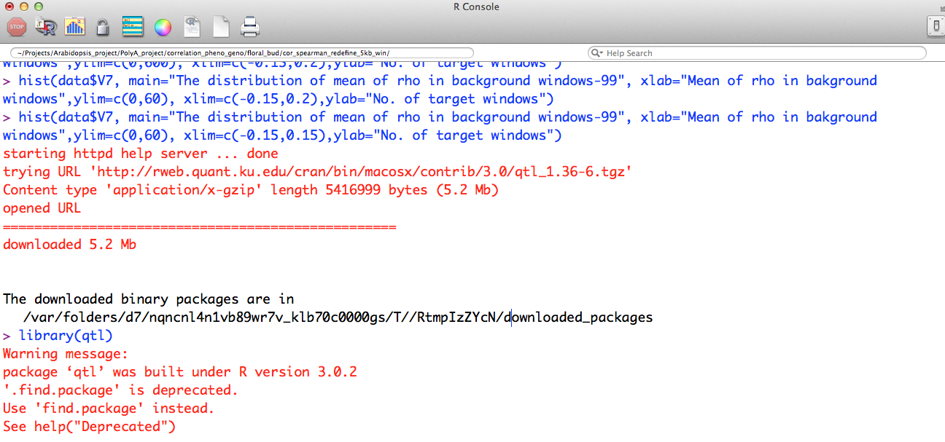
Install R/qtl
Open R
Packages & Data -> Package installer
Highlight qtl
Click “ Install Selected”
or:
install.packages("qtl")
Check:
> library(qtl)

Slide 17
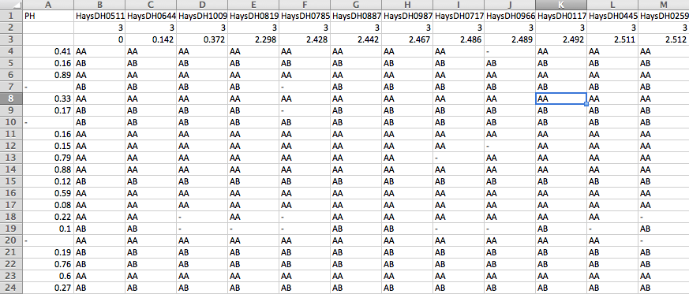
Format data: .csv
Construct linkage map
phenotype
Marker ID
Chromosome NO.
Marker location on Chromosome

Slide 18
1. Read file
rm(list=ls())
ls()
help.start(): e.g. help(read.cross)
setwd("/Users/lilei/Projects/other_people_data/mycorn_data_20140605/phs_hessifly_qtl_with_RQTL")
getwd()
library(qtl)
mapthis <- read.cross("csv", http://129.130.89.83/tmp/public/PLPTH613_2015Spring/datasets, “3A_PHS.csv", genotypes=c("AA","AB"), na.string="-",estimate.map=FALSE, alleles=c("A","B"))

Slide 19
2. Check the general information
summary(mapthis)
plot(mapthis)
plotMap(mapthis,show.marker.names=F)
plotPheno(mapthis, pheno.col=1)
plotMissing(mapthis, reorder=TRUE)

Slide 20
3. Remove markers without genotype data
mapthis <- drop.nullmarkers(mapthis)
totmar(mapthis)
4. Estimate recombination fractions between all pairs of markers and plot them
mapthis <- est.rf(mapthis)
plotRF(mapthis)

Slide 21
5. Re-estimate the genetic map and plot the original map against the newly estimated one
newmap <- est.map(mapthis, error.prob=0.01)
plotMap(mapthis, newmap)
6. Replace the the genetic map with
the estimated one
mapthis <- replace.map(mapthis, newmap)
7. Calculate the erro LOD score
mapthis <- calc.errorlod(mapthis, error.prob=0.01)
8. List the genotypes that maybe in erro
top.errorlod(mapthis)

Slide 22
9. QTL mapping
mapthis <- calc.genoprob(mapthis, step=2, off.end=0.0, error.prob=1.0e-4,map.function="haldane",stepwidth="fixed")
mapthis.scan1 <- scanone(mapthis, pheno.col=1,model="normal",method="em")
plot(mapthis.scan1)

Slide 23
10. Significance threshold
mapthis.scan1.perm <- scanone(mapthis, n.perm=100)
thresh1 <- summary(mapthis.scan1.perm , alpha=c(0.63,0.10,0.05))
thresh1
abline(h=thresh1[1],lty="dotted",lwd=1,col="blue")
abline(h=thresh1[2],lty="dotted”,lwd=1,col="green")
abline(h=thresh1[3],lty="dotted”,lwd=1,col="red")
summary(mapthis.scan1, perm=mapthis.scan1.perm , lodcolumn=1, alpha=0.01)

